Slide 1

Overview Automation, Performance & Security Testing
Presented By:
Nitin Sharma(Apr-2019)
This document and all its contents contain information from Cybage Software Private Limited which may be privileged, confidential, or otherwise protected from disclosure. The information is intended to be for the addressee(s) only. Any unauthorized disclosure, copy, distribution, or use of the contents of this message is strictly prohibited.
Notes:
Greetings and Introduction !!!

Slide 2

www.cybage.com
Agenda
Automation Overview
Need for Test Automation
When to start Automation
Automation Portfolio
Test Automation Strategy
Automation Processes
Tools
Performance Overview
Performance Testing
Performance Portfolio
Why Performance testing
Performance Objectives and counters
Performance Testing Strategy
Virtual Users
Tools

Slide 3
www.cybage.com
Agenda
Security Overview
Software Security Introduction
Security Keywords
OWASP Top 13 – 2013 Introduction
Security Testing Strategy
Tools & Techniques
Security Read & References

Slide 4
Automation Testing
Test metrics
Carrier-specific validation testing
Iterative
Unit
Defect Leakage
Availability
End–to–End
Cloudera
Commercial tools
SIT
TSR
AWS
Cross-platform testing
UAT
Microsoft
Mobile Testing
Mobile Testing
Services Integration
V-Model
Hybrid
Compliance testing
Risk
Big Data
Scalability
Coexistence
Wire Shark
HP
White box
Grid simulation and evaluation
Coverage
Azure
Automation
Open source tools
Big Data
End–to–End
Methodology
Record and playback
BugZilla
TM
Defect
Performance
Keyword-driven
WebScrab
Data-driven
White box
Security
Reliability
SOAPUI
Functional decomposition
System
Test plan
Hadoop
SELENIUM
AUT
QTP
Cross-platform testing
Grey box
TDD
IBM
Automation
Scrum
Mobile Testing
Jira
Bug
OEM package validation
Customized tools
Scripting
Black box
Notes:
Overview:
1) Expertise in engineering test automation solutions
2) Proficiency in all the leading test automation tools and technologies
3) Experience in designing and implementing test frameworks e.g.. (Modular, Data-driven, Keyword-driven, Hybrid)
4) Flexible solutions - customized to run in different environments

Slide 5
Need for Test Automation
Speed up testing time
Improve Test Coverage
Ensure consistency
Replicate testing across different platforms
Higher degree of Repeatability and Control
Precise reporting of Test Results.
Copyright © 2011 Cybage Software Pvt. Ltd. All Rights Reserved. Cybage Confidential.

Slide 6
When to start Automation
Product /Environment Stability
Well Documented Business logic / workflow
Manual Test Cases covers business requirements
Successful executed Manual Test Cases
Functionality remains unchanged
Defined scope of Automation coverage.
Copyright © 2011 Cybage Software Pvt. Ltd. All Rights Reserved. Cybage Confidential.

Slide 7
Test Automation | Portfolio
GUI
DB
API/SDK
Build
Regression
Functional
Smoke
Record - playback
Library-based
Data-driven
Keyword-driven
Hybrid
Notes:
Test Automation Portfolio
Inner circle – These are the various approaches we follow for creating different Automation Frameworks.
Details On Framework :
Hybrid framework (5th Generation) - The most commonly implemented framework which is a combination of all the available techniques, pulling from their strengths and trying to mitigate their weaknesses. This hybrid framework is what most frameworks evolve into overtime and multiple projects.
Keyword Driven (4th Generation) – aka Table Driven - This framework involves creation of many keyword functions which are application independent.
Tests are no longer developed using code, but rather developed using keywords in tabular format, that is interpreted and executed by a driver script or utility.
Data Driven (3rd Generation) - In this Framework , while Test Case logic resides in Test Scripts, the Test Data is separated and kept outside the Test Scripts. Test Data is read from the external files (Excel, CSV, XML, Database) which are used in Test scripts for execution and output validation.
Library based ( 2nd Generation ) - aka Functional Decomposition or Modular - This framework involves division of the AUT into modules, and developing modular functions. Each module represents smallest functional unit and is independent of other modules.
Record and Playback (1st Generation) - In this Framework , Tester manually records each step ( Navigation and User Inputs), Inserts Checkpoints ( Validation Steps) in the first round. He then , Plays back the recorded script in the subsequent Rounds
Middle circle –Automation can be done, to achieve various testing objectives like Functional, Regression and Smoke testing.
Outer Circle - Using these approaches and keeping in mind the objectives, test automation can be done for various GUI and non GUI aspects of testing like DB, API/SDK, command line test and Build.
Build – To identify unstable builds by automating Test process in Build setup. [Continuous Integration]
API/SDK - Non GUI tests like API/SDK and command line tests.
DB- Database Testing
GUI – Graphical User Interface testing.
[ANSWER TO QUESTION]
Sanity testing determines whether it is reasonable to proceed with further testing.
Smoke testing is used to determine whether there are serious problems with a piece of software, for example as a build verification test.
Functional testing is mainly to check functional aspects of an application which it is suppose to and not suppose to do.
Smoke and Sanity can be subset of functional testing.
--------------------------------------------
Different Framework PROS and CONS:
Record and Playback:
Pros:
Fastest way to generate script
Automation expertise not required
Easiest way to learn the features of the Testing Tool
Cons:
Little reuse of scripts
Test Data is hard coded into the script
Maintenance Nightmare
2. Library based:
Pros –
Higher level of code reuse is achieved
The automation scripts are less costly to develop due to higher code re-use
Easier script maintainability
Cons –
Technical expertise is required to write scripts
More time is needed to plan and prepare test scripts
Data exists within scripts
Framework highly dependent on the application
3. Data Driven:
Pros –
Changes to the Test Scripts do not affect the Test Data
Test Cases can be executed with multiple Sets of Data
Redundancy and unnecessary duplication of test scripts gets greatly reduced.
A Variety of Test Scenarios can be executed by just varying the Test Data in the External Data File
Better error handling as we can do output data based validation
Cons –
One to one test case-script / data mapping result into large number of test scripts
Still has high maintenance cost as any change in Application functionality requires making necessary modifications in multiple test scripts, data files
Technical expertise required to write scripts.
4. Keyword Driven:
Pros –
Less code, No Test script development efforts, Ease of maintenance
Highly scalable
Application independent
Manual testers are responsible for defining automation tests
Cons –
Requires initial investment for design and implementation of the framework
Required seasoned automation professional for framework implementation
Initial time investment needed for learning keywords usage. This can slow
down test case development productivity
5. Hybrid:
This is the most commonly implemented framework which is a combination of all the available techniques, pulling from their strengths and trying to mitigate their weaknesses. This hybrid framework is what most frameworks evolve into overtime and multiple projects.
Pros –
More flexibility since framework is customized as per application needs
Other benefits such as Maintainable, Manageable, Reusable

Slide 8
Test Automation | Strategy
Feasibility Analysis
Scope & Planning
Design & Development
Execution
Maintenance
Application Study
Tool Identification
Proof-Of-Concept
Scope Definition
Test Planning
Defining Automation Approach
Estimation
Framework
Script
Data Creation
Review and Rework
Automation execution
Analysis
Reporting
Script
Data
Framework
Notes:
Phase 1:
Feasibility Analysis:
Application Study – Study and understanding of the Application Under Test
Tool Identification - Depending upon the technologies being used and stability of the application, few automation testing tools would be evaluated which would include standard commercial tools and open source tools
POC – With the selected tool, we will develop small test suite that could demonstrate the tool capabilities and the automation concept.
This helps to analyze whether the identified tool is appropriate to go ahead with Automation or not. [Challenges Faced, Workarounds,
Advantages, Limitations etc.. are some of the outcomes of the POC. ]
Phase 2:
Scope and Planning:
Scope Definition – From the existing manual test cases, test scenarios would be identified for creation of automated scripts. These will be divided into High/Low/Medium complexities test cases.
Test Planning - After automation testing tool is identified, automation test plan would be created, which would include a high level plan and approach for conducting automation testing.
Defining Automation Approach – Best suitable Automation approach will be defined
Estimation – After Automation scope is defined, high level Estimation is done.
Phase 3:
Design and Development:
Framework - As part of this, reusable function libraries, test reporting structure, coding standards, exception handling etc.. strategies would be designed and developed.
Script - Based on the test scenarios, test scripts would be created and after dry run/debugging, the scripts would be finalized so that they are ready to run in the test environment.
Data creation - Necessary Test Data would be created.
Review and Rework - All this will be reviewed and rework would be done, wherever required.
Phase 4:
Execution:
Execution – Depending upon the test cycle and testing requirements, test sets would be executed in test environments as part of build cycle.
Analysis - The test results would be analyzed for Pass/Failed test cases.
Reporting - Defects would be reported/ updated in the defect tracking tool.
Phase 5:
Maintenance:
Script – For the recently modified functionality, the automated test scripts, UIMaps need to be changed so that it gets executed successfully for the next run.
Data – Test Data needs to be updated in case of any changes in data driven test cases.
Framework – Function libraries need to be updated in case we need to add any additional common functions.

Slide 9
Automation Processes
Application Study
High level Estimates
Proposal
Feasibility Study
Knowledge Transfer
Planning
Design
Execute And Analysis
Maintenance
Updating Test Scripts
Adding New Test Scripts
Identifying Resources
Ramp-up on Domain and Product
Requirement Analysis
Identifying Test cases to be Automated.
Automation Test Plan
Framework Design
Identifying Test Data
Creating Functional Libraries
Creating Test Scripts
Execute Scripts
Analyzing Results
Reporting Defect
Notes:
Smart Art - update

Slide 10






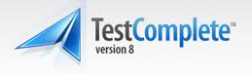





Test Automation | Tools
Licensed
Open Source
Notes:
Cybage QA team utilizes top-of-the-line tools for performing QA and Testing for clients. The QA team has expertise on working on a wide variety of tools, from the licensed as well as the open-source arena
Above are few of the tools that are used in Cybage
Note:
Empirix – eTester
Compuware – Test Partner

Slide 11
Performance Testing
Carrier-specific validation testing
Unit
Test metrics
End–to–End
Scripting
Coexistence
Availability
AWS
Defect Leakage
SIT
End–to–End
Azure
Services Integration
Coverage
Big Data
Scalability
Commercial tools
UAT
Compliance testing
Wire Shark
White box
HP
Automation
J Meter
Cross-platform testing
Big Data
Defect
bandwidth
Risk
WebScrab
Mobile Testing
White box
Security
Performance
TM
Cloudera
Response Time
BugZilla
V-Model
Memory
IBM
TSR
Methodology
Microsoft
Load Runner
Reliability
Grid simulation and evaluation
Configuration
Load
Cross-platform testing
Open source tools
AUT
Mobile Testing
Stress
TDD
Performance
Test plan
Scrum
Grey box
Jira
Hadoop
Endurance
Bug
OEM package validation
Mobile Testing
Scripting
Black box
Customized tools
Spike
Notes:
In Cybage , we have focused group of experience test engineering's on performance testing . As previously discussed this group works on approach's , methods , best practices and build expertise across organization .

Slide 12
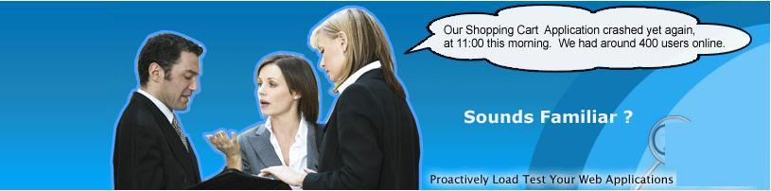
Real time Scenario
This may happen with your site too !

Slide 13
Performance Testing
Performance Testing
Responsiveness
Speed
Stability
Scalability

Slide 14
Performance Testing: Goal
Establish a Baseline
Eliminate Bottlenecks

Slide 15
Performance Testing | Portfolio
Load
Benchmarking
Stress
Performance
Spike
Endurance
Notes:
Portfolio includes
Load testing to determine a system’s behavior under both normal and anticipated peak load conditions.
Stress Testing to determine the stability of a given system or entity beyond normal operational capacity
Endurance testing to determine system behavior under sustained use.
Spike test to determine system’s capacity and response to sudden increase in load .
Benchmarking against the requirement specified to assess the relative performance of system.

Slide 16
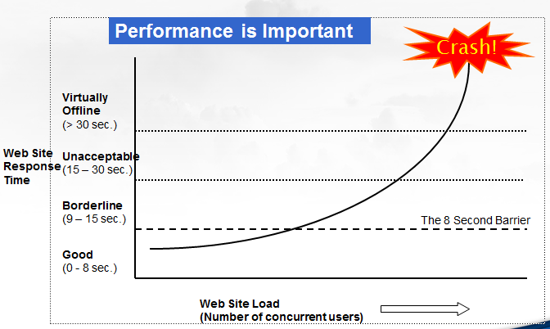
Why Performance

Slide 17
Performance Objectives
Performance objectives are usually specified in terms of
response times
throughput (transactions per second),
resource-utilization levels
and typically focus on metrics that can be directly related to user satisfaction
Performance Objectives
The performance-testing effort was based on the following overall performance objectives:
Ensure that the new production hardware is no slower than the previous release.
Determine configuration settings for the new production hardware.
Performance Constraints
No server should have sustained processor utilization above 80 percent under any anticipated load. (Threshold)
Notes:
Portfolio includes
Load testing to determine a system’s behavior under both normal and anticipated peak load conditions.
Stress Testing to determine the stability of a given system or entity beyond normal operational capacity
Endurance testing to determine system behavior under sustained use.
Spike test to determine system’s capacity and response to sudden increase in load .
Benchmarking against the requirement specified to assess the relative performance of system.

Slide 18
Sample Performance Counters
Performance Counter Category | Counter Name | Threshold Limits
Processer | % Processor Time | <80%
 | % Privileged Time | < 30% of Total %Processor Time
Memory | % Committed Bytes In Use | <80%
 | Available Mbytes | >20% of Physical RAM
 | Pages/sec | Should not exceed 5 pages/second
Network Interface | Bytes Total / sec | <50% of Current Bandwidth of NIC
Physical Disk | Avg. Disk Queue Length | <4
 | Disk Bytes/sec | As high as possible
System | Context switches / sec | 1500-3000 per processor
 | Processor Queue Length | <3 * (Number of Processors)
 | Threads | A value that is too high may be a cause of concern.
Process | % Processor Time | <70%
SQL | SQL Server: locks - Lock waits/sec -- _Total | Preferred value is 0
 | Number of Deadlocks/sec | Preferred value is 0

Slide 19


Virtual Users
Notes:
Why Virtual users?
Importance of VU
Limitations of Individuals over infrastructure required for Performance testing

Slide 20
Performance Testing | Strategy
Discover
Analyze
Plan
Design and Build
Execution
Application
Infrastructure
Platform
SLA
Configuration
Implementation
Data
Feasibility
Strategy
Scenarios
Monitoring
Environment
Script and Data
Execution
Analysis
Reporting
Notes:
Performance testing methodology involves–
Discovery – In this phase we understands application and all the related layers of the application impacting performance like platform , infrastructure etc. with application SLA .
Analyze – Here we understand various configuration , integrations of system with business level details like data, userflow etc.
Plan – Under this, based on previous phases we plan the overall execution, monitoring & reporting.
Design and Build – This is a phase where team actually script the user flow, generate and integrate actual data to make virtual user mimic actual users. Various load scenarios prepared under this phase and verified for it’s correctness. Test environment, application deployment are part of this phase .
Execution: Various rounds of load test execution happens under this phase. These executions gets fine tuned based on previous execution results . And if require previous phases gets revisited .After every execution each and every monitoring data gets collected and analyzed to identify bottlenecks , improvement area.
Report – Various reports, artifacts gets created through out phases and shared, reviewed with client.

Slide 21
Performance Testing | Strategy
Performance Strategies
Identify the Test Environment
Identify Performance Acceptance Criteria
Plan and Design Tests
Configure the Test Environment
Implement the Test Design
Execute test & Analyze Results, Report,
Notes:
Performance testing methodology involves–
Discovery – In this phase we understands application and all the related layers of the application impacting performance like platform , infrastructure etc. with application SLA .
Analyze – Here we understand various configuration , integrations of system with business level details like data, userflow etc.
Plan – Under this, based on previous phases we plan the overall execution, monitoring & reporting.
Design and Build – This is a phase where team actually script the user flow, generate and integrate actual data to make virtual user mimic actual users. Various load scenarios prepared under this phase and verified for it’s correctness. Test environment, application deployment are part of this phase .
Execution: Various rounds of load test execution happens under this phase. These executions gets fine tuned based on previous execution results . And if require previous phases gets revisited .After every execution each and every monitoring data gets collected and analyzed to identify bottlenecks , improvement area.
Report – Various reports, artifacts gets created through out phases and shared, reviewed with client.

Slide 22
Performance Testing | Strategy
Activity | Input | Output
Identify the Test Environment | Logical and physical production architecture Logical and physical test architecture Available tools | Comparison of test and production environments Environment-related concerns Determination of whether additional tools are required
Identify Performance Acceptance Criteria | Client expectations Risks to be mitigated Business requirements Contractual obligations | Performance-testing success criteria Performance goals and requirements Key areas of investigation Key performance indicators Key business indicators
Notes:
Performance testing methodology involves–
Discovery – In this phase we understands application and all the related layers of the application impacting performance like platform , infrastructure etc. with application SLA .
Analyze – Here we understand various configuration , integrations of system with business level details like data, userflow etc.
Plan – Under this, based on previous phases we plan the overall execution, monitoring & reporting.
Design and Build – This is a phase where team actually script the user flow, generate and integrate actual data to make virtual user mimic actual users. Various load scenarios prepared under this phase and verified for it’s correctness. Test environment, application deployment are part of this phase .
Execution: Various rounds of load test execution happens under this phase. These executions gets fine tuned based on previous execution results . And if require previous phases gets revisited .After every execution each and every monitoring data gets collected and analyzed to identify bottlenecks , improvement area.
Report – Various reports, artifacts gets created through out phases and shared, reviewed with client.

Slide 23
Performance Testing | Strategy
Activity | Input | Output
Plan and Design Tests | Available application features and/or components Application usage scenarios Performance acceptance criteria | Conceptual strategy Test execution prerequisites Tools and resources required Application usage models to be simulated Test data required to implement tests
Configure the Test Environment | Conceptual strategy Available tools Designed tests | Configured load-generation and resource-monitoring tools Environment ready for performance testing
Notes:
Performance testing methodology involves–
Discovery – In this phase we understands application and all the related layers of the application impacting performance like platform , infrastructure etc. with application SLA .
Analyze – Here we understand various configuration , integrations of system with business level details like data, userflow etc.
Plan – Under this, based on previous phases we plan the overall execution, monitoring & reporting.
Design and Build – This is a phase where team actually script the user flow, generate and integrate actual data to make virtual user mimic actual users. Various load scenarios prepared under this phase and verified for it’s correctness. Test environment, application deployment are part of this phase .
Execution: Various rounds of load test execution happens under this phase. These executions gets fine tuned based on previous execution results . And if require previous phases gets revisited .After every execution each and every monitoring data gets collected and analyzed to identify bottlenecks , improvement area.
Report – Various reports, artifacts gets created through out phases and shared, reviewed with client.

Slide 24
Performance Testing | Strategy
Activity | Input | Output
Implement the Test Design | Conceptual strategy Available tools/environment Available application features Designed tests | Validated, executable tests Validated resource monitoring Validated data collection
Execute the Test | Task execution plan Available tools/environment Available application features Validated, executable tests | Test execution results
Analyze Results, Report, and Retest | Task execution results Performance acceptance criteria Risks, concerns, and issues | Results analysis Recommendations Reports
Notes:
Performance testing methodology involves–
Discovery – In this phase we understands application and all the related layers of the application impacting performance like platform , infrastructure etc. with application SLA .
Analyze – Here we understand various configuration , integrations of system with business level details like data, userflow etc.
Plan – Under this, based on previous phases we plan the overall execution, monitoring & reporting.
Design and Build – This is a phase where team actually script the user flow, generate and integrate actual data to make virtual user mimic actual users. Various load scenarios prepared under this phase and verified for it’s correctness. Test environment, application deployment are part of this phase .
Execution: Various rounds of load test execution happens under this phase. These executions gets fine tuned based on previous execution results . And if require previous phases gets revisited .After every execution each and every monitoring data gets collected and analyzed to identify bottlenecks , improvement area.
Report – Various reports, artifacts gets created through out phases and shared, reviewed with client.

Slide 25
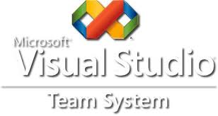








Performance Testing | Tools
Licensed
Open Source
Notes:
We do have extensive exposure on various licensed as well as open source performance test tools. This includes various tools for load generation, server monitoring, for profiling and to generate reports . Such as VSTS, J Meter , Nagio , Munin etc.

Slide 26
Security Testing
HP
End–to–End
Test metrics
Hybrid
Defect Leakage
Cloudera
Availability
Carrier-specific validation testing
Performance
BugZilla
Keyword-driven
Big Data
SIT
Reliability
Cross-platform testing
Microsoft
Commercial tools
V-Model
Security
SELENIUM
Record and playback
AWS
WebScrab
Services Integration
Unit
Scalability
TSR
Mobile Testing
Automation
Grid simulation and evaluation
White box
Test plan
Burp
Wire Shark
Methodology
Defect
Coverage
Big Data
White box
Open source tools
Coexistence
Exploit
Session
Grey box
TDD
Risk
IBM
End–to–End
Azure
Security
TM
Hadoop
Metasploit
Misconfiguration
XSS
Authentication
Mobile Testing
Scripting
Https
Attack
Wireshark
AUT
Cross-platform testing
CSRF
Scrum
Injection
Jira
Bug
OEM package validation
Cryptography
Black box
Customized tools
Notes:
Cybage offers security testing for web applications based on OWASP Top 10. Which caters all the verticals.

Slide 27

Security
Unauthorized Access
Disclosure
Modifications
Destruction
Disruption

Slide 28
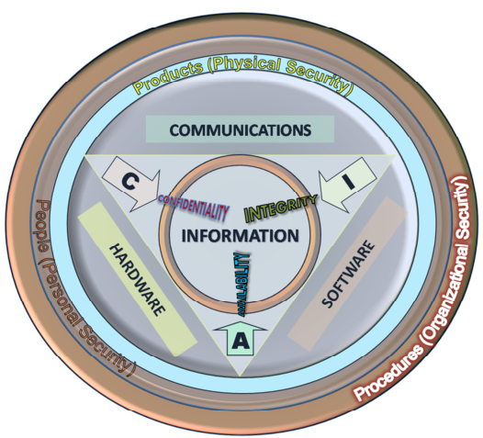
Security

Slide 29
Software Security
“Software security is about making software behave correctly in the presence of a malicious attack”
It includes
Authentication
Authorization
Accountability
Notes:
Authentication
Authentication is the mechanism whereby systems may securely identify their users. It provides an answers to the questions:
Who is the user?
Is the user really who he/she represents himself to be?
Authorization
Authorization, by contrast, is the mechanism by which a system determines what level of access a particular authenticated user should have to secured resources controlled by the system.
Accountability
It is responsibility to someone or for some activity.

Slide 30
Software Security Keywords
Security
Assets
Vulnerability
Threats
Attacks
Counter-measure
(Threat & Risk mitigation)
Assessments
Notes:
Security testing portfolio includes
- Threat modeling of an application which identifies application threats based on Microsoft STRIDE threat categories
Security Compliance testing based on regulatory standard such as PCI, HIPPA
Vulnerability assessment of web applications and Reports
Web application penetration testing based on OWASP Top 10 and Reports
Asset An IT asset is any company-owned information, system or hardware that is used in the course of business activities
Threat A threat is a possible danger that might exploit a vulnerability
Vulnerability A security hole/weakness in software which allows an attacker to reduce a system's Information Assurance
Attack Is to exploit vulnerability in software to gain control of it
Countermeasure A safeguard that addresses a threat and mitigates risk
Assessment Practice to identify threat, damage ,security holes in software

Slide 31
Driving Factors of Software Security
Change in Environment
Change in assumptions
Change in usage
Change in attacks
New attack tools
…….

Slide 32
Security Testing | Strategy
Plan
Discovery
Attack
Analysis
Report
Test Planning and Scoping
Client Approvals
Map App Content
Analyze the Application
Run Scanner
Manual Exploit
Access/Input Handling
Vulnerability Analysis
Additional Discovery
Risk Rating
Report Creation
Notes:
This is how we perform security testing –
Plan – Identify Application scope, security testing scope, test environment and required approval
Discovery – In this phase we map application visible and hidden content, identify different technologies involved and map attack surface
Attack – Here we perform manual penetration testing based on attack surface and run Burp/open source scanner
Analysis – We do analysis of findings, remove false positive, if any, and perform additional discovery, if required
Report – We create report of findings and assign risk rating for identified vulnerabilities

Slide 33
OWASP Top 10 - 2013
The Open Web Application Security Project (www.owasp.org)
Awareness for “The Ten Most Critical Web Application Security Risks”
Injection: Whenever untrusted data is sent to an interpreter as a part of a command or query [SQL Injection, LDAP]
BASM: Whenever application functions related to authentication and session management is not implemented properly. [Broken Authentication and Session Management]
XSS: Whenever an application takes untrusted data and sends it to web browser without proper validation.
[Cross Site Scripting ]

Slide 34
OWASP Top 10 - 2013
IDOR: Whenever a developer exposes a reference to an internal implementation object, such as a file, directory, or database key. [Insecure Direct Object References]
Sec. Misconfig: Whenever application, frameworks, application/web/db server security is not defined/configured/maintained properly.
SDE: When Unprotected transactions done via Credit Cards, Tax Id, Authentication credentials.
[ Sensitive Data Exposure]
MFLAC: If requests are not verified on both Server and client side , attackers will be able to forge requests in order to access functionality without proper authorization.
[Missing Function Level Access Control]

Slide 35
OWASP Top 10 - 2013
CSRF: Whenever vulnerable web application thinks victim forged HTTP (including victim’s session cookie) request as legitimate. [Cross-Site Request Forgery ]
UCKV: Applications using components with known vulnerabilities may undermine application defenses and enable a range of possible attacks and impacts.
[Using Components with Known Vulnerabilities]
URF: Whenever web applications frequently redirect and forward users to other pages and websites, and use untrusted data to determine the destination pages. [Invalidated Redirects and Forwards]

Slide 36
Sample Sql Injection
Sql Injection
select * from dbo.Employee where EmployeeName like ‘Amit’
select * from dbo.Employee where EmployeeName like ‘Amit’ Or 1=1 --
Insert into DB using SQL Injection:
string query = select * from dbo.Employee where EmployeeName like 'Amit’ ;insert into users (id, username, pword) values (3,'Nitin','Pune');--

Slide 37

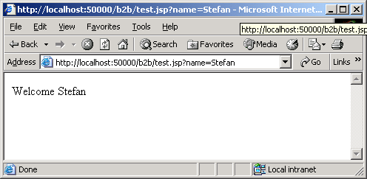
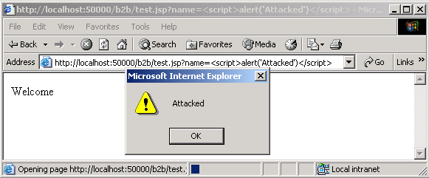
Sample XSS Attack
http://myserver.com/test.jsp?name=Stefan
<HTML>
<Body>
Welcome Stefan
</Body>
</HTML>
http://myserver.com/welcome.jsp?name= <script>alert("Attacked")</script>
<HTML>
<Body>
Welcome <script>alert("Attacked")</script>
</Body>
</HTML>

Slide 38










Security Testing | Tools
Licensed
Description
Tools
Open Source
WebScrab
Notes:
Tools –
We have expertise on various licensed as well as open source security testing tools such as Burp, Cenzic Hailstorm, W3af, Metasploit, WebScarab.

Slide 39
Security Read and Reference
www.owasp.org
en.wikipedia.org/wiki/Security_testing
msdn.microsoft.com/en-us/library/ee823878(CS.20).aspx
msdn.microsoft.com/en-us/library/ff648644.aspx

Slide 40

Thank you!
Copyright © 2012 Cybage Software Pvt. Ltd. All Rights Reserved. Cybage Confidential.

